Slide 1
Cloud Native Meets GenAI: Unleashing the Future
Mahesh Kasbe

Slide 2
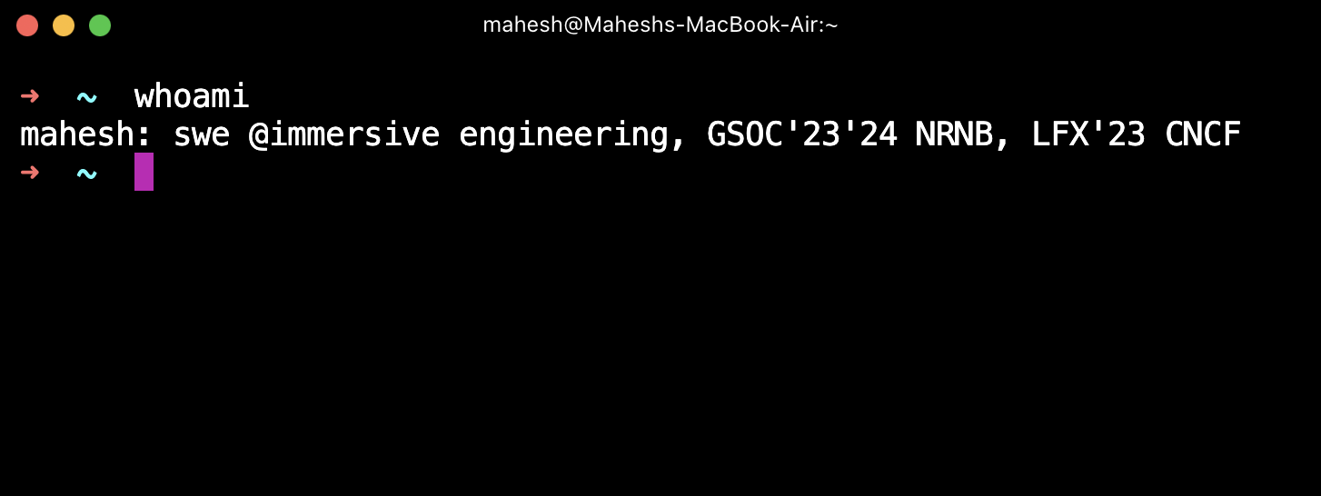
Whoami???

Slide 3
Agenda
Introduction to LLM’s
Introduction to RAG
What are agents
Components of LLM Agents
Why GenAI in cloud Native
What future holds
Conclusion

Slide 4
Introduction to LLMs
Large language models are computational models that are capable of modeling and generating human language. LLM’s have the transform ability to predict the likelihood of word sequence or generate new text based on a given input.
What are LLMs good at???
Text generation/code generation
Chatbots and conversational ai
Information retrieval
Sentiment analysis
Input: 5 “tokens” -> i, like, cats, more, than
Output: 1 “token” -> dogs

Slide 5
When can LLMs fail?
Complex reasoning tasks: LLMs have limited reasoning capacity, LLMs are good knowledge retrievers but not good reasoners
No dynamicity: LLMs are static and unable to access real time information
Limited knowledge(hallucination): While trained on vast data, LLMs lack up to date knowledge

Slide 6
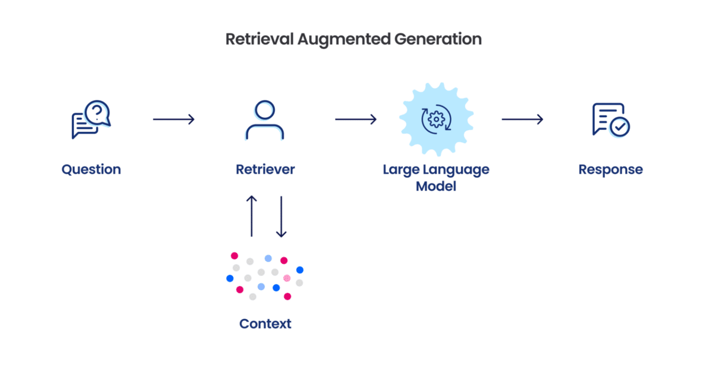
RAG - Retrieval Augmented generation

Slide 7
LLM Agents
LLM agents, also known as Large language model agents, leverage LLMs to execute complex tasks by integrating them with essential components like planning and memory.
LLM Agent = LLM + Tools + State
LLM: Computational engine i.e “brain”
Tools: agents ability to interact with the external world
Memory/State: agents memory of previous message and results from used tools

Slide 8
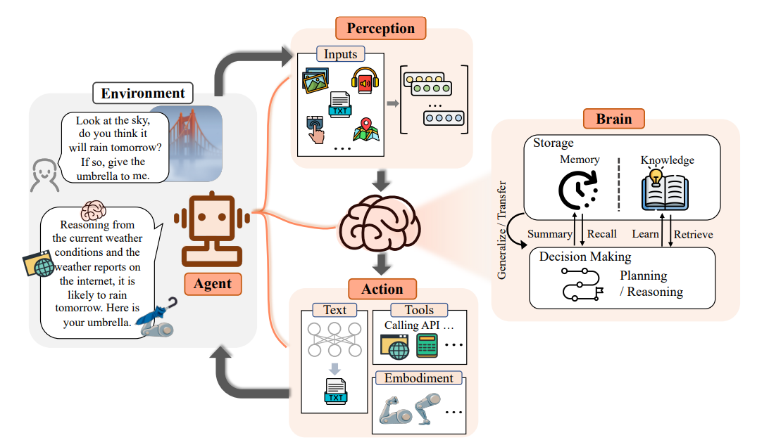
Components of LLM Agents
LLM - Computational engine “brain”
Planning - Chain of thought process to create a plan for executing tasks
Tools - executable functions, APIs
Memory - short term memory to retain agents thought, long term memory to retain context
Actions - performs actions based on their environment and reasoning

Slide 9

“Imagine if your cloud infrastructure could predict and fix problems on its own using AI predictions—all while you sip your coffee. That’s not just the future; it’s happening now.”
A frustrated devops engineer like me(us)

Slide 10
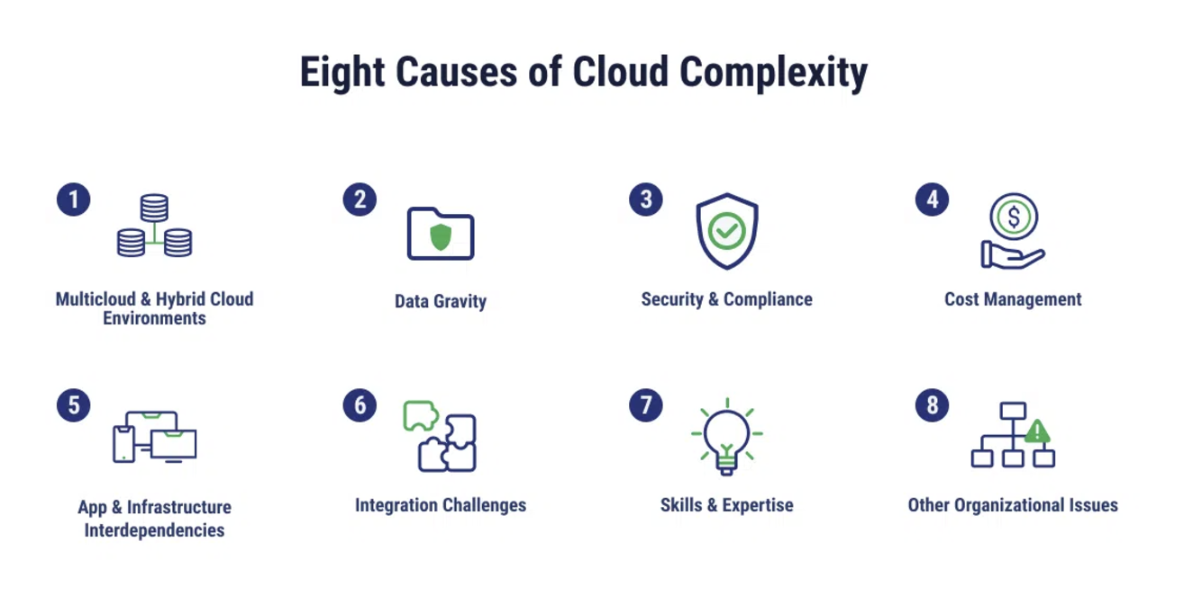
Why GenAI in Cloud Native??
Complexity!!!

Slide 11
What does future hold??? (A prediction)
AI-native Kubernetes clusters that "just work" without manual intervention.
Integration of GPT-5-like models into every aspect of cloud management.
The rise of fully autonomous DevOps workflows driven by Generative AI.
The ability to automatically optimize cloud resources, reduce downtime, and cut costs will transform how companies manage their cloud infrastructure, making them more competitive in the market.

Slide 12
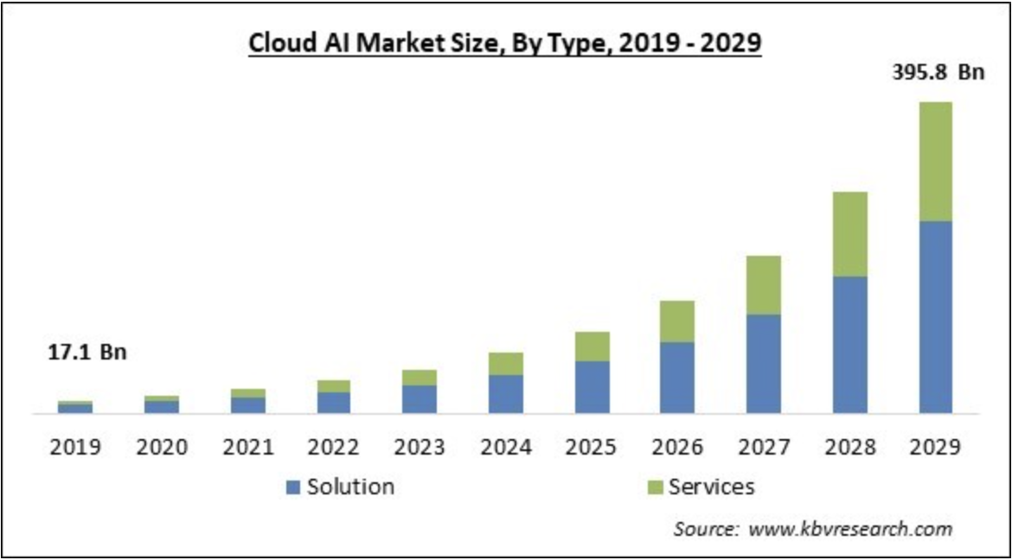

Slide 13
Thank You!
Say hi to me!!!
X (Twitter): @mhshx_
Linkedin: Mahesh Kasbe

